Slide 1
CMS HL7® FHIR® Connectathon 6
The Centers for Medicare & Medicaid Services (CMS) is proud to again bring stakeholders together virtually for the 6th Annual HL7® FHIR® Connectathon taking place July 15-17, 2025.
Registration is free and will close on Friday, June 30th
The CMS eQM Standards Team will lead the FHIR Quality Reporting with DEQM track to perform a dry run of FHIR quality reporting with data exchange for quality measures (DEQM) eligible clinician (EC) and eligible hospital (EH) programs and provide a demonstration of reporting both an NHSN Hospital Safety measure and a CMS EH measure using the same submission.
Overview of track page
Overview of draft schedule

Slide 2
Track Objectives
Quality Reporting with DEQM
Population Reporting without Supporting Data
e.g. Eligible Clinician (EC)
Population Reporting with Supporting Data
e.g. Eligible Hospital (EH)
NHSN and CMS Reporting
Hypoglycemia measure using the same submission data

Slide 3
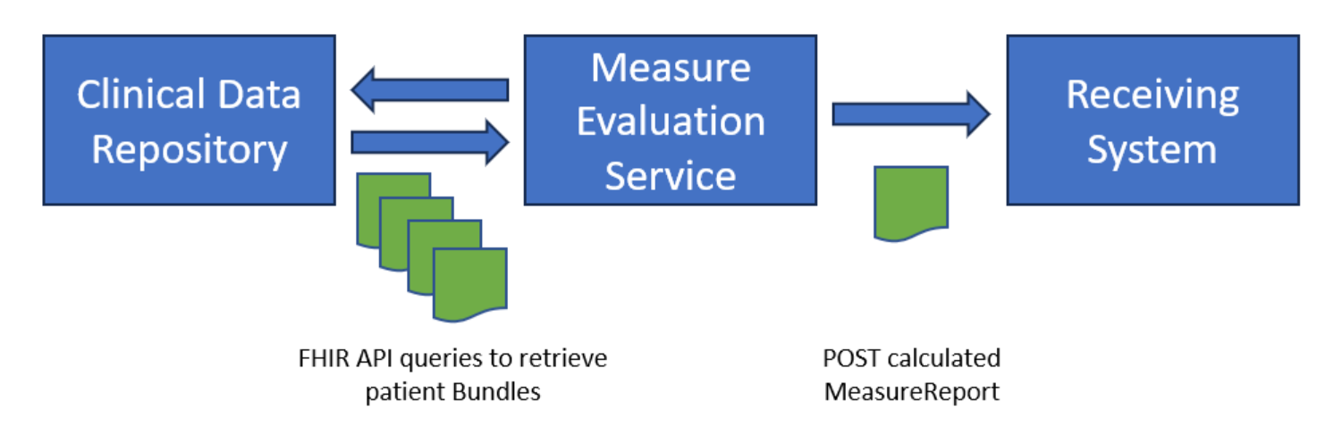
Population Reporting without Supporting Data

Slide 4
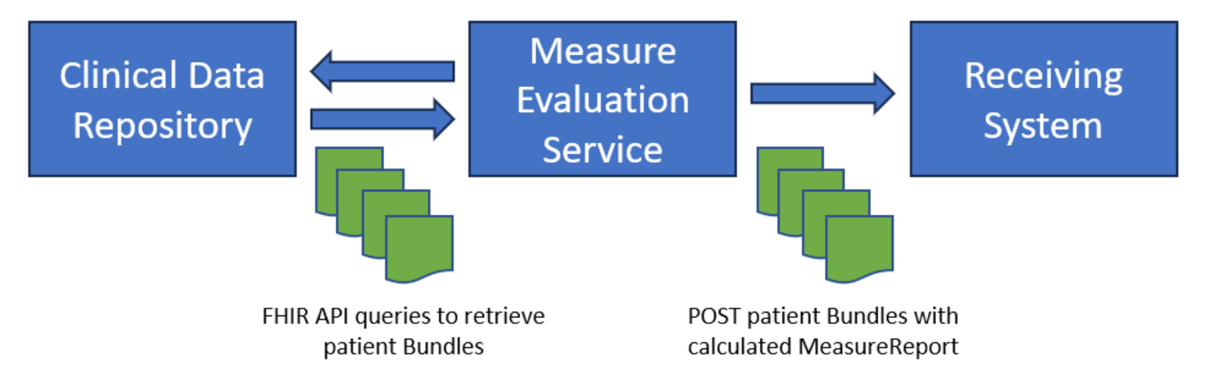
Population Reporting With Supporting Data

Slide 5
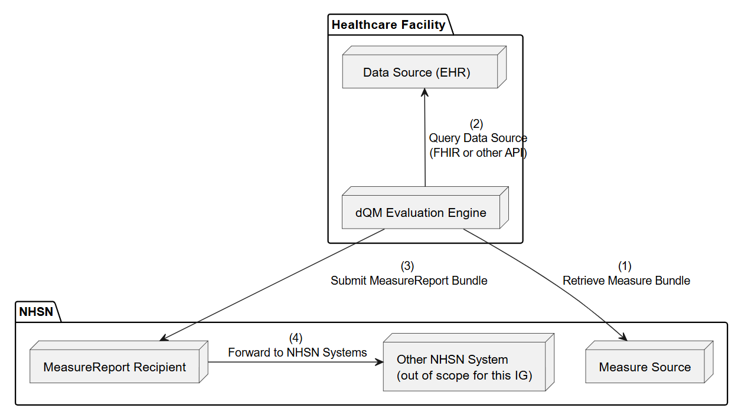
NHSN and CMS Hospital Reporting

Slide 6
Roles
Clinical Data Repository
Source system exposing a FHIR API
USCore 6.1.0, Ideally QICore 6.0.0
Measure Evaluation Service
Retrieves data-of-interest
Performs the calculation
Posts results
Receiving System
FHIR API (DEQM Receiving System Capability Statement)

Slide 7
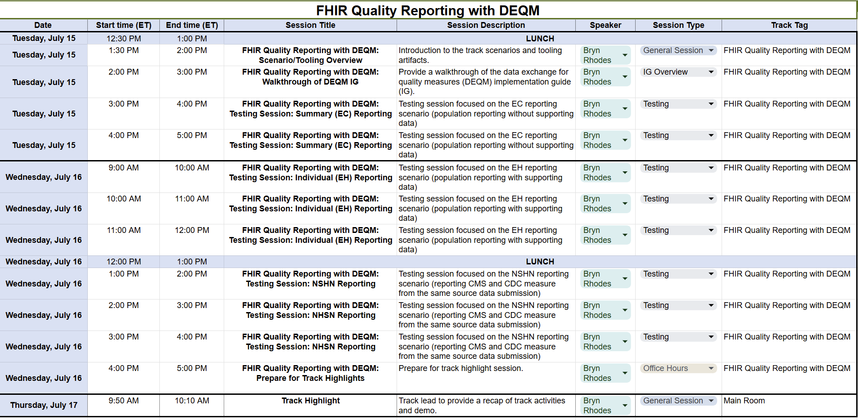
Final Track Schedule

Slide 8
Next Steps
Join the planning session on Wednesday at 10 am ET. Meeting and login details can be found on the track page.
Track Planning: Wednesday, July 9
If you are interested in participating, leading a session during the track, suggesting a session topic, or receiving meeting invites, please reach out to us at fhir@icf.com.

